Slide 1
Problems
on
Trains

Slide 2
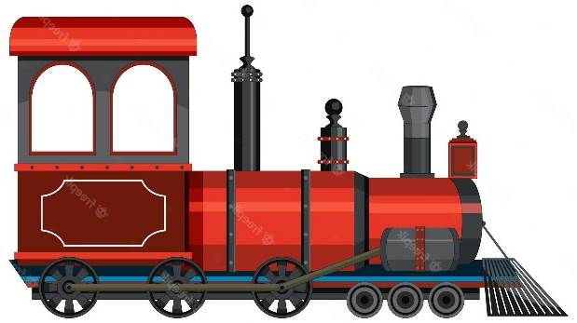
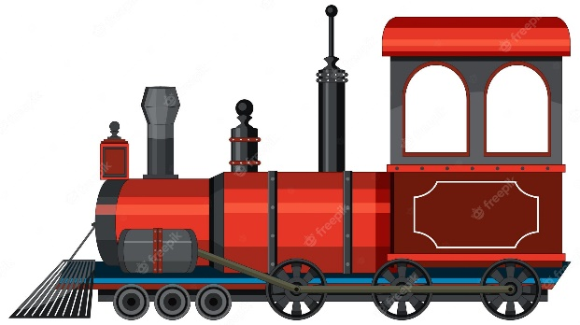
RELATIVE SPEED
S₁ S₂
RELATIVE SPEED
S_{R} = S₁ + S₂
(CROSSING)
S₁
S₁
RELATIVE SPEED
S_{R} = S₁ – S₂
S₂

Slide 3


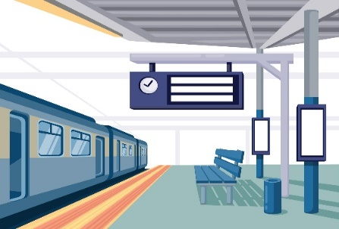
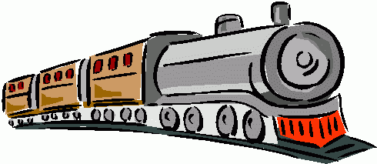

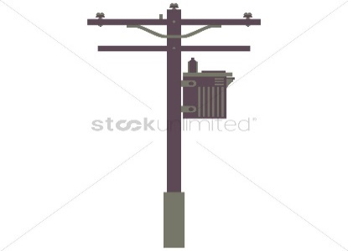

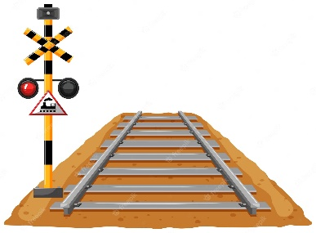
Point Object and Length Object
Length object:
Train Tunnel Bridge Platform
Point object:
Traffic signal Man Electric Pole Car

Slide 4
TRAIN PROBLEMS
Train problems broadly centre around the following three types.
L_{t}= Length of the train
S = Speed of the train
T = Time taken
1. Length object crossing the point object
Distance Travelled = Length of the train
Time taken(T) = L_{t} / S
2. Length object crossing the length object
Distance Travelled = Length of train + length of object
Time Taken = (L_{t} + SL )/ S
3. Length object crossing movable length object
Distance Travelled = Length of train + length of object Speed by which trains are moving = Relative Speed(S_{R})
Time Taken = (L_{t1} + L_{t2} )/S_{R}

Slide 5
1. Two trains are running In opposite direction with the same speed. If the length of each train is 135 meters and they cross each other in 18 seconds, the speed of each train is
29 km/hr
35 km/hr
27 km/hr
54 km/hr
Notes:
C

Slide 6
2. Two trains with lengths of 200 m each are moving in opposite directions. They cross each other in 16 seconds. If one is moving twice as fast as the other, then the speed of the faster train is:
A. 30 km/hr
B. 45 km/hr
C. 60 km/hr
D. 75 km/hr

Slide 7
3. A train passes a station platform in 36 seconds and a man standing on the platform in 20 seconds. If the speed of the train is 54 km/hr, then what is the length of the platform?
200 m
240 m
300 m
864 m

Slide 8
4. Two men start travelling in the opposite direction up to a point where the other started. If they take 13 minutes and 52 minutes respectively to reach the other end, after how much time (all in minutes) would they have met?
39
10.4
26
Cannot say

Slide 9
5. A train travelling at 42 km/h passes a runner in 9 seconds running in same direction and took 5 seconds in the opposite direction. Find the length of the train.
75 m
100 m
84 m
90 m

Slide 10
6. A man standing on a railway platform notices that a train going in one direction takes 10 seconds to pass him and other train of the same length takes 15 seconds to pass him. Find the time taken by the two trains to cross each other when they are running in the opposite direction (all in seconds).
12
14
13.5
15
Notes:
A

Slide 11
7 .The ratio of the speed of two trains is 5:8. Sum of their length is 880. The ratio of time taken to cross an electric pole by train A and B is 4:3. What is the difference between the length of two trains?
A.50m
B.40m
C.80m
D.45m
Notes:
Difficulty level:- Moderate (Compulsory)
Answer: C) 80m
Explanation:
Ans.
Given that length of first train + length of second train = 880
Speed of first train : Speed of second train = 5:8 =5x : 8x
Time taken to cross the poll by two trains = 4:3 =4y:3y
Now ,
(5x*4y) + (8x*3y) = 880
44xy = 880
xy = 20
L1 - L2 = 24xy -20xy = 4xy = 80 m

Slide 12
8. A train of length 4 km is running at a speed of 60 kmph. In what time, it will pass a man who is running 20 km ahead of it with a speed of 20km/h .(in the same direction in which the train is going)?
A. 48 min
B. 54 min
C. 24 min
D. 36 min
Notes:
Difficulty level:- Moderate (Optional)
Answer:D
Relative speed = 60-20=40km/h
Distance the train has to cover to pass a man=4+20=24 km
Now,
T=(24/40)*60 = 36 min

Slide 13
9.A man sitting in a train which is travelling at 36 kmph observes that a goods train, travelling in opposite direction, takes 10 seconds to pass him. If the goods train is 280 m long, find its speed.?
A.18 m/sec
B.20m/sec
C.15m/sec
D.10m/sec
Notes:
Difficulty level:- Moderate (Compulsory)
Answer: A
Explanation: Speed of normal train =36 x 5/18 m/sec=10m/sec
Let
Sg = Speed of good train
10 =(280)/(sg+10)
Sg=18 m/sec

Slide 14
10. A 230 meters long train running at the speed of 120 kmph crosses another train running in opposite direction at the speed of 80 kmph in 9 seconds. What is the length of the other train ?
A.270m
B.240m
C.260m
D.320m
Notes:
Difficulty level:- Easy (Optional)
Answer: A) 270 m
Explanation:
Relative speed = (120 + 80) km/hr
=(200*5/18)m/s = (500/9)m/s
Let the length of the other train be x metres.
Then, x+230/9 = 500/9
=> x + 230 = 500
=> x = 270.

Slide 15
11. 8 hrs after a goods train passed a station, another train travelling at a speed of 54 km/hr following that goods train passed through that station. If after passing the station the train overtakes the goods train in 13 hours. What is the speed of the goods train?
A.39.6km/h
B.49.5 km/h
C.33.43 km/h
D.26.4km/h
Notes:
Difficulty level:- Easy (optional)
Answer: C
Let Speed of good train =xkm/h
Therefore, Distance travelled by good train in 8 hrs =8x
Speed of another train= 54km/h (given)
Therefore, Relative speed=54-x
Since, T= d/S
Therefore, 13=8x/(54-x) => x=33.43 km/h

Slide 16
12. A car travelling in fog passed a man walking at 3 km/h in the same direction. He could see the car for 4 minutes and up to a distance of 100 m. What is the speed of the car (all in km/h)?
40.5
4.5
1.5
5.5
Notes:
B

Slide 17
13. A car travelled a distance of 600 km in 6 hours. The first part of the journey is covered with a speed of 70 km/h and the rest of the journey is covered with the speed of 120 km/h. The distance covered in the first part of the journey is
240 km
120 km
168 km
None of these

Slide 18
14. Two trains of length 115 m and 110 m respectively run on parallel rails. When running in the same direction, the faster train passes the slower one in 25 seconds, but when they are running in opposite directions with the same speeds as earlier, they pass each other in 5 seconds. Find the speed of the faster train.
27 m/s
18 m/s
36 m/s
None of these

Slide 19
15. A train travelling at a speed of 75 mph enters a tunnel 7/2 miles long. The train is 1/2 mile long. How long does it take for the train to pass through the tunnel from the moment the front enters to the moment the rear emerges?
2 minutes
B. 3.2 minutes
C.4.4 minutes
D.5.4 minutes
Notes:
Difficulty level:- Easy (Optional)
Answer: B) 3.2 min
Explanation:
Total distance covered =(7/2+1/2) =4 miles
Time taken = (4/75)* 60 = 16/5 = 3.2 minutes

Slide 20
16. Two stations A and B are 100 km apart on a straight track. One train starts from A at 7:30 a.m. and travels towards B at 20 kmph. Another train starts from B at 8 a.m. and travels towards A at a speed of 25 kmph. At what time will they meet?
11:00 a.m.
09:00 a.m.
10:00 a.m.
09:10 a.m.

Slide 21


